Slide 1


Excel Engineering College (Autonomous) Komarapalayam – 637 303 Department of Artificial Intelligence and Data Science
AI-Based Resume Detection and Analysis System
Presented by
Priya Kumari (730922201087)
Santhosh M R (730922201099)
Manivannan M (730922201306)
Raja S (730922201308)
Under the Guidance of
Ms. S.Manju vidhya, B.E,M.E.,
Assistant Professor

Slide 2
Agenda
Abstract
Objectives
Problem Statement
Existing System
Proposed System
Software used
Architecture / Methodology Used
System Design/flow chart /DFD/ER/Use cases
Modules
Testing/Performance Evaluation /Results
Conclusion and Future Enhancements
Screenshot
References

Slide 3
ABSTRACT
This project aims to build an AI-based system that automatically reads, extracts, and analyzes resumes. Recruiters often face difficulties while checking hundreds of resumes manually. Our system solves this problem using Artificial Intelligence and Natural Language Processing (NLP) to pick out important details like name, contact, skills, education, and work experience from PDF resumes. It then compares these details with job requirements and gives a match score. This helps companies save time, reduce human error, and choose the best candidates easily. The project is developed using Python (Flask), HTML, CSS, and JavaScript, and supports database storage for future reference.

Slide 4
OBJECTIVES OF THE PROJECT
To create a system that automatically reads and analyzes resumes.
To extract key information like name, skills, education, and experience from resumes.
To match the extracted skills with job requirements using AI and NLP.
To help recruiters shortlist suitable candidates quickly and accurately
To reduce manual effort and save time in the hiring process.

Slide 5
PROBLEM STATEMENT
The main problem is that the traditional resume screening process is time-consuming and inaccurate. Due to human error and manual filtering, recruiters may miss out on ideal candidates. So, there is a need for a smart, automated system.

Slide 6
Literature survey
Traditional resume screening is time-consuming and often inaccurate. Most systems use keyword matching, which may miss the real potential of a candidate.
Recent studies suggest using Artificial Intelligence (AI) and Natural Language Processing (NLP) for better resume analysis. Tools like spaCy, NLTK, and PyMuPDF help extract important information from resumes effectively.
Our project builds on these technologies to create a smart system that automates resume reading and matches candidate skills with job requirements accurately.

Slide 7
PROPOSED SYSTEM
The proposed system is an AI-powered web application that helps recruiters automatically read and analyze resumes. Users can upload resumes in PDF format. The system uses Natural Language Processing (NLP) to extract important information like name, contact details, skills, education, and experience. After extracting the data, the system compares the candidate’s skills with the required job description and calculates a matching score. This score helps recruiters easily identify the most suitable candidates. The system also stores the results for future reference and provides an easy-to-use dashboard for viewing and filtering applicants. This reduces manual work, saves time, and improves the overall hiring process.

Slide 8
SOFTWARE USED
We have used the following technologies to build our system:
Frontend: HTML, CSS, JavaScript
Backend: Python with Flask Framework
Libraries: PyMuPDF for PDF reading, spaCy, and NLTK for Natural Language Processing
Database: MySQL

Slide 9
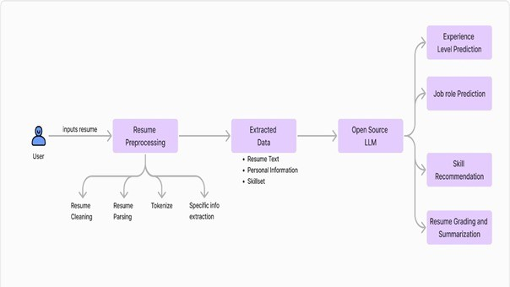
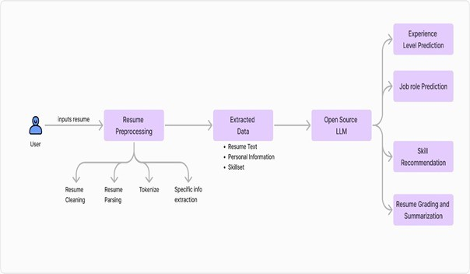
FLOW CHART

Slide 10
MODULES
The main modules of our system are:
Resume Upload and Parsing
Information Extraction
Skill Matching with Job Description
Admin Panel to view all results
Analytical Reports for better decision-making

Slide 11
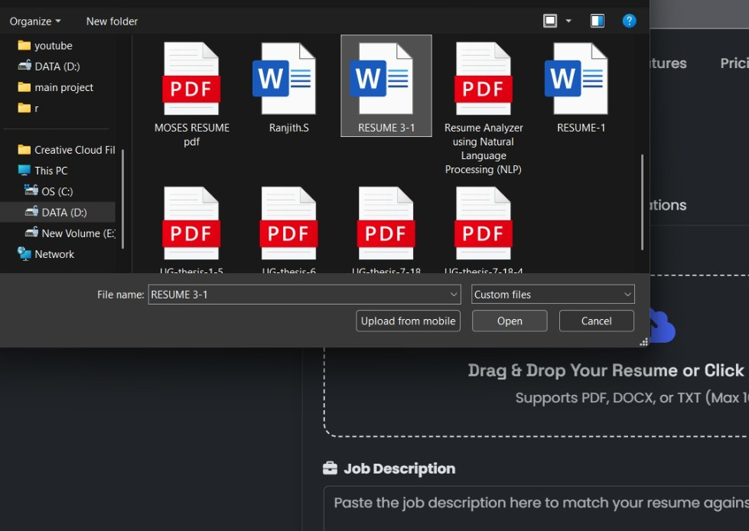
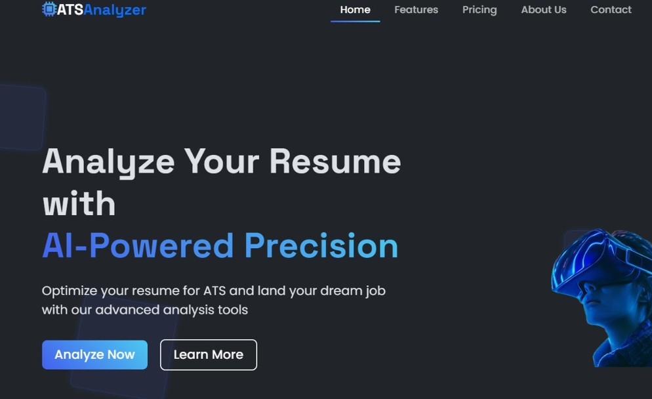
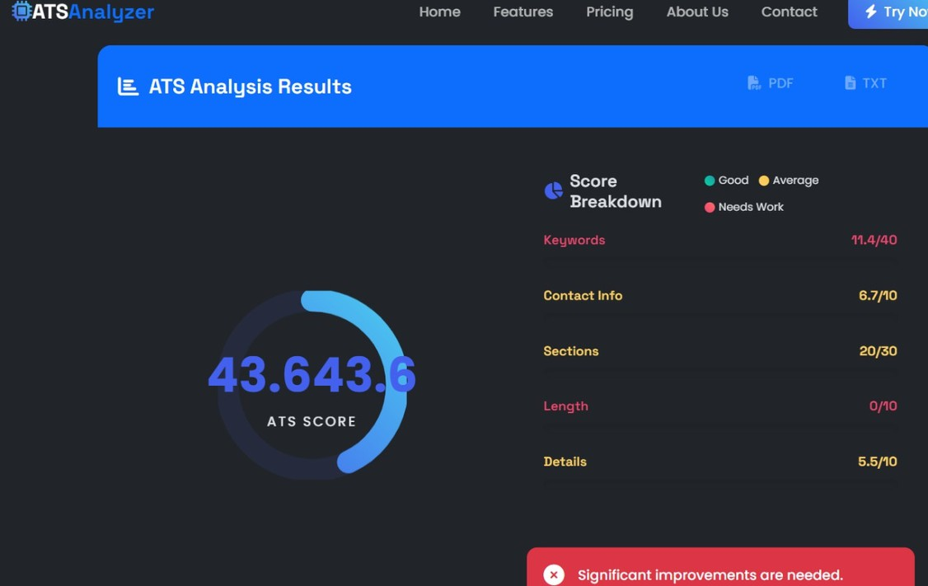
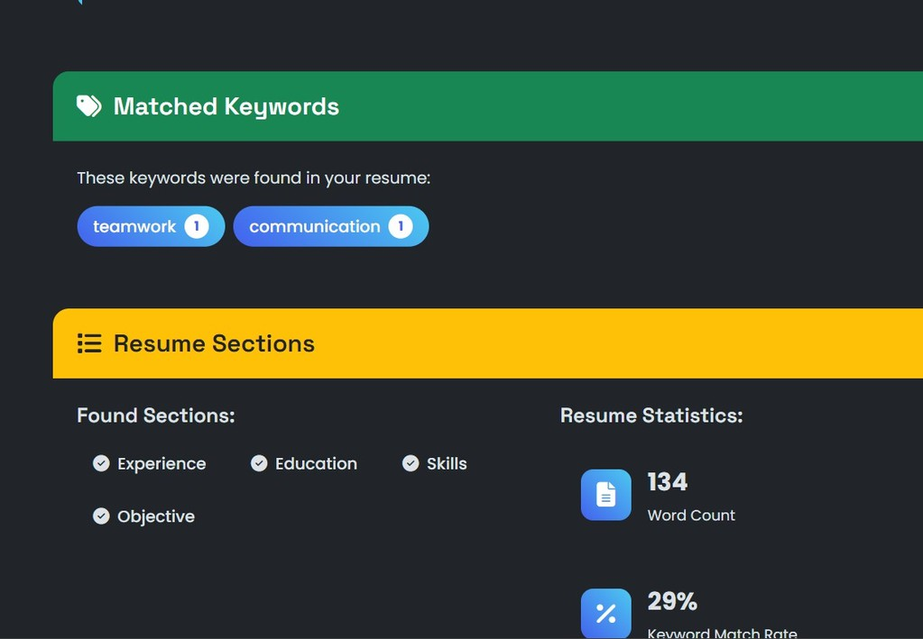
TESTING/PERFORMANCE EVALUATION/RESULTS/comparison chart (any one)

Slide 12
CONCLUSION
In this project, we developed an AI-based system that makes resume screening faster, smarter, and more accurate. It automatically extracts important information from resumes and matches them with job requirements using AI and NLP. This system reduces manual effort, saves time, and helps recruiters find the right candidates easily. Overall, it improves the recruitment process and makes it more efficient.

Slide 13
FUTURE ENHANCEMENTS
AI Interview Bot Integration: Add an AI chatbot to conduct initial screening interviews based on the resume content.
Voice Resume Parser: Allow candidates to record voice introductions, and the system can analyze tone, clarity, and confidence.
Fraud Detection System: Use AI to detect fake or copied resume content by comparing it with global resume databases.
Emotional Tone Analysis: Analyze the writing tone of resumes (formal, confident, confused) to help recruiters understand personality traits.
Diversity and Inclusion Check: Ensure unbiased shortlisting by checking for gender-neutral language and inclusive hiring.

Slide 14
REFERENCES
Research Paper: "Automated Resume Screening using Natural Language Processing" – IEEE, 20212.
spaCy Documentation – https://spacy.io/
PyMuPDF Documentation – https://pymupdf.readthedocs.io/
NLTK (Natural Language Toolkit) – https://www.nltk.org/
Flask Documentation – https://flask.palletsprojects.com/
"Machine Learning for Resume Screening" – International Journal of Computer Applications, 2020
Various online tutorials and GitHub repositories related to AI-based resume parsing and NLP

